Slide 1
NAME:Sunkara Sai Manas
Branch/sec:CSE 3
ROLL NO.26000200

Slide 2
CASE-5:Digital Library Management Interface
Design a library website with book categories, book covers, author details, availability labels, search and filter interface elements, and library rules. Use CSS Grid and structured tables for displaying catalog information.

Slide 3
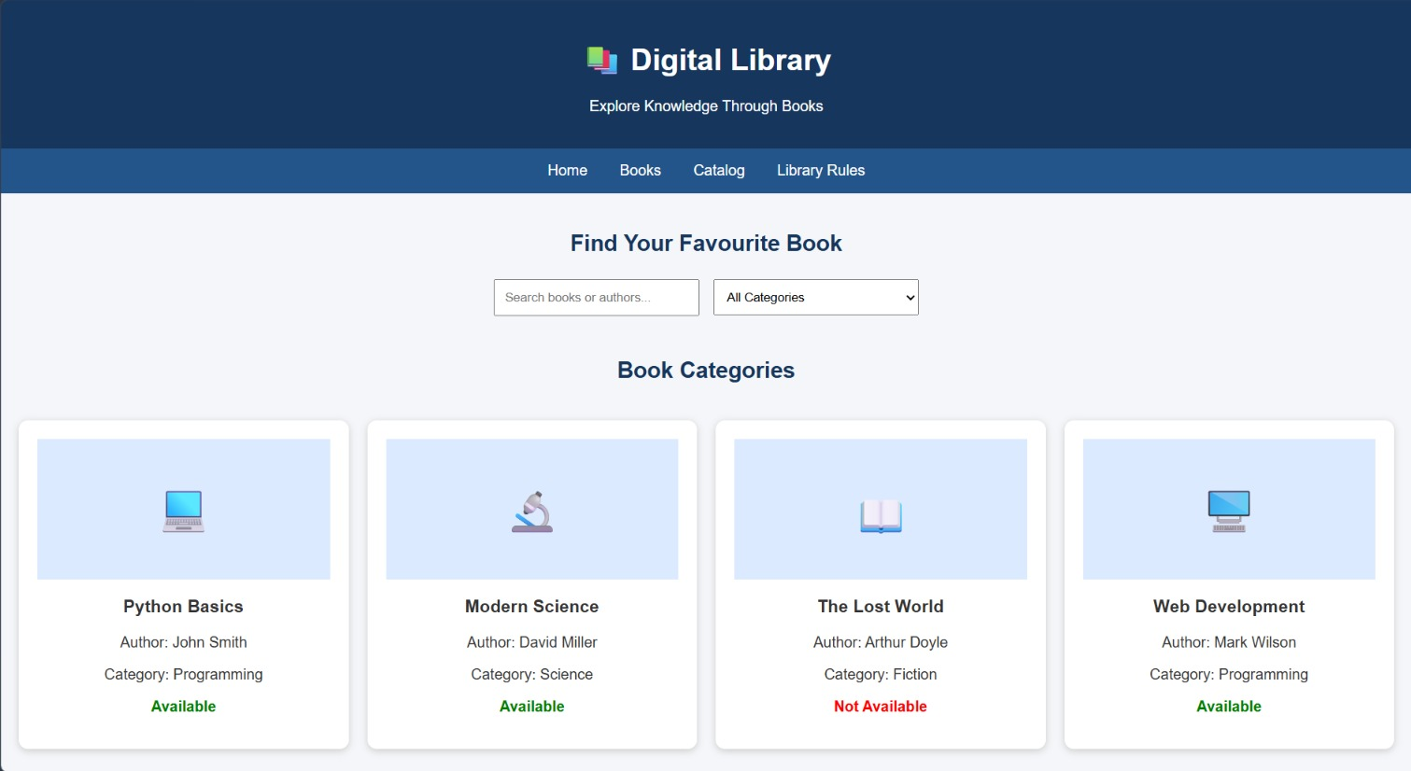

Slide 4
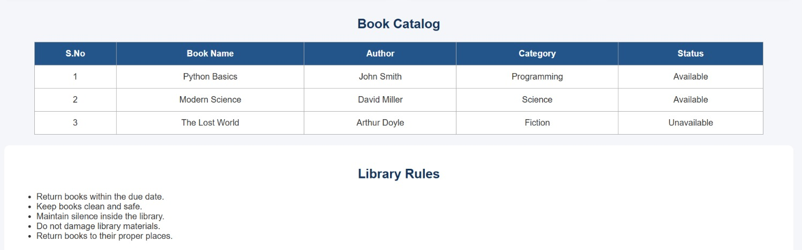

Slide 5
CASE-6:Online Shopping Website
Create an e-commerce interface displaying products, prices, discounts, ratings, categories, product descriptions, and shopping buttons. Design a responsive product grid, promotional banners, and a shopping navigation bar.

Slide 6
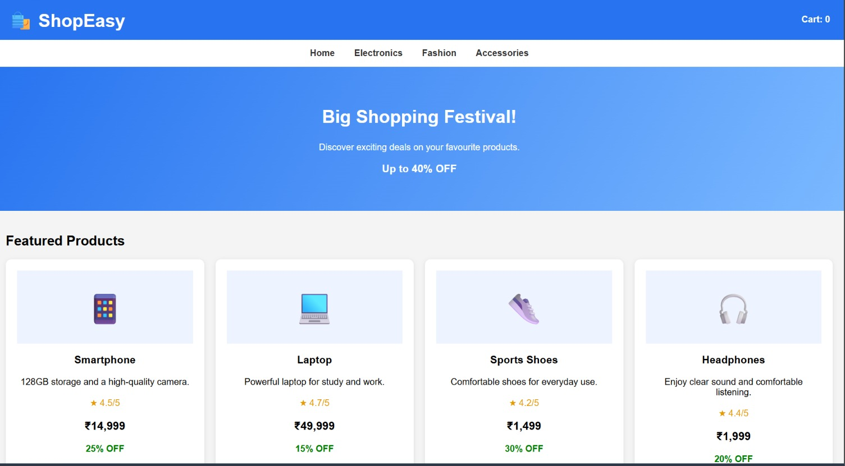

Slide 7
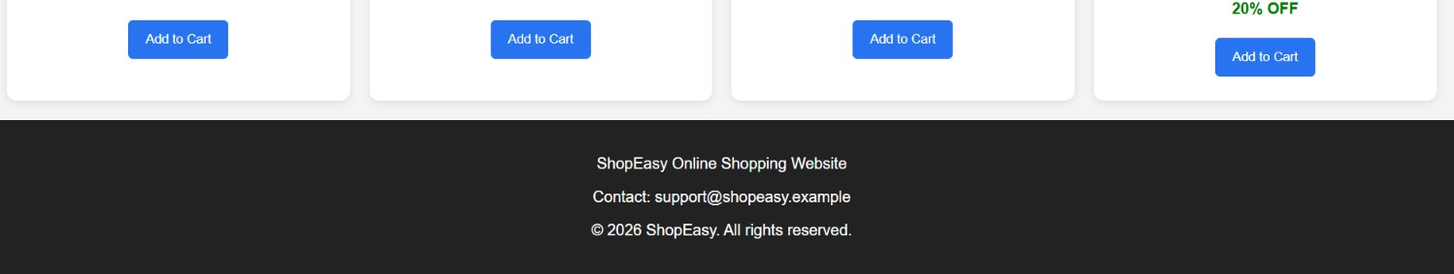

Slide 8
CASE-7:Electronics Store Website
Develop an online electronics catalog for laptops, smartphones, accessories, and smart devices. Include product comparison tables, specifications, discount labels, category filters, and product detail layouts.

Slide 9
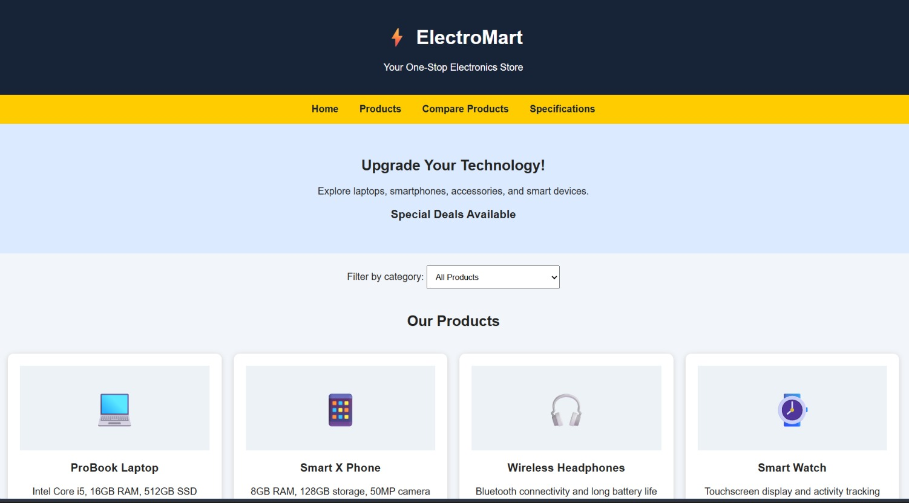

Slide 10
